Slide 1

RANI CHENNAMMA UNIVERSITY, BELAGAVI
B.V.V.SANGHA’S
BASAVESHWAR SCIENCE COLLEGE, BAGALKOT
DEPARTMENT OF COMPUTER SCIENCE
SYNOPSIS ON
LEAVE MANAGEMENT SYSTEM
INTERNAL GUIDE TEAM MEMBERS
PROF.SHRIDHAR PANGI RAMYA JOSHI-M1915672
PRIYA PATTAR – M1915666
AKHILA P K – M1915606

Slide 2
Modules:
ADMIN
STAFF
HOD
PRINCIPAL

Slide 3
DATA FLOW DIAGRAM
A data flow diagram (DFD) is a traditional visual representation of the information flows within a system. A neat and clear DFD can depict the right amount of the system requirement graphically.
ZERO LEVEL DFD:
LEAVE MANAGEMENT
STAFF
ADMIN
FIRST LEVEL DFD:
ADMIN
Login
Staff
Principal

Slide 4
DATA FLOW DIAGRAM:-
ADD STAFF
INVALID
ADMIN
LOGIN
ADD LEAVES
Leave Details
VIEWS SANCTION REPORTS

Slide 5
Invalid
View
Login
Approve
Principal
Leave Details
Cancel
Leave
Invalid
Apply
Leave
Login
Staff
Leave Details
View
Status

Slide 6
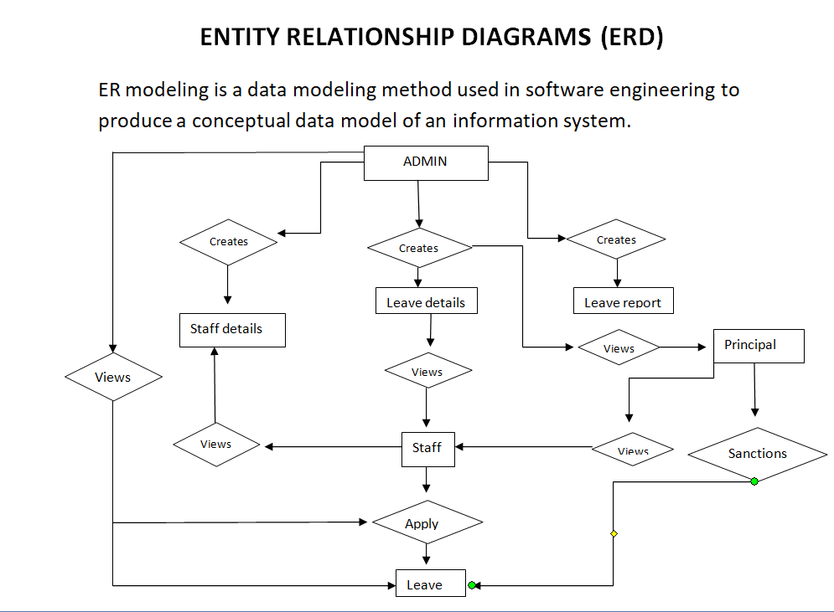
A

Slide 7
Admin_Login:
User
Name
Login_id
password
ADMIN_LOGIN

Slide 8
Staff:
Staff_name
Staff_id
Dept
STAFF
Mobile no
Staff_Type
Username
Password

Slide 9
Leave Application:
Staff_name
App_No
Leave_Type_id
Applying
date
LEAVE
APPLICATION
Leave
reason
Starting
date
Ending
date
No of
days

Slide 10
Leave_Details:
Leave_Det_id
Leave_Type_id
Used
leaves
Staff_name
LEAVE_DETAILS
Balance
leaves
Application
number

Slide 11
Leave_Report:
Medical leave
Earn leave
Restricted holiday
Casual leave
Maternity leave
Type_name
Duty leave
Description
Leave_Type_id
LEAVE_REPORT
Number of
Leaves/year

Slide 12
Leave_Sanction:
Sanction_id
Staff_name
LEAVE_SANCTION
Sanction Date
Sanction
Status

Slide 13
Leave Management
Login
Add Staff
Add leave
Details
ADMIN
Apply for
leave
Sanction
Leave
View Sanction
Report
View
Status
PRINCIPAL
STAFF

Slide 14
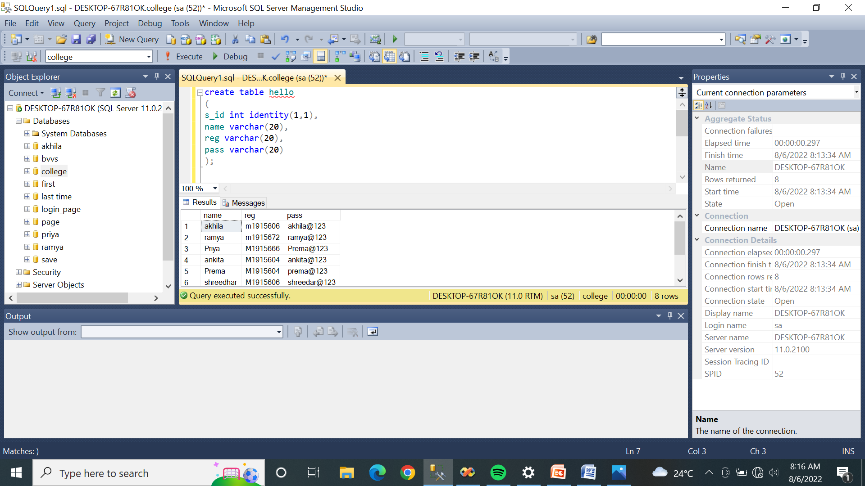

Slide 15
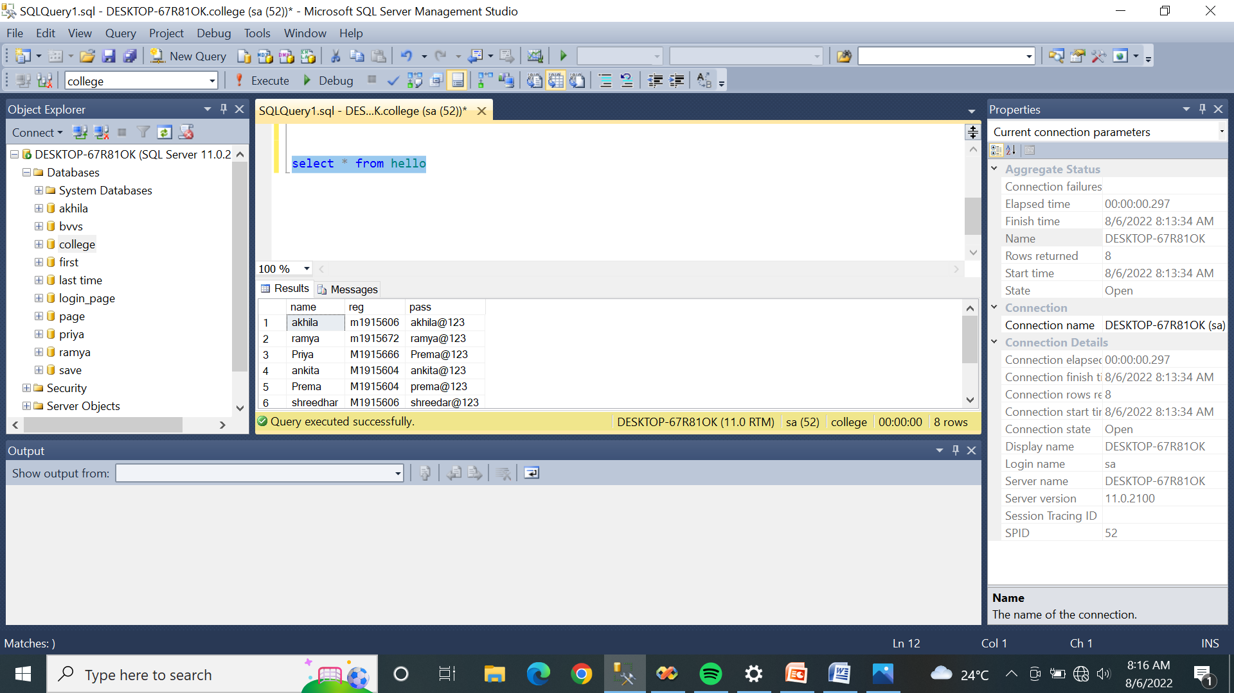

Slide 16
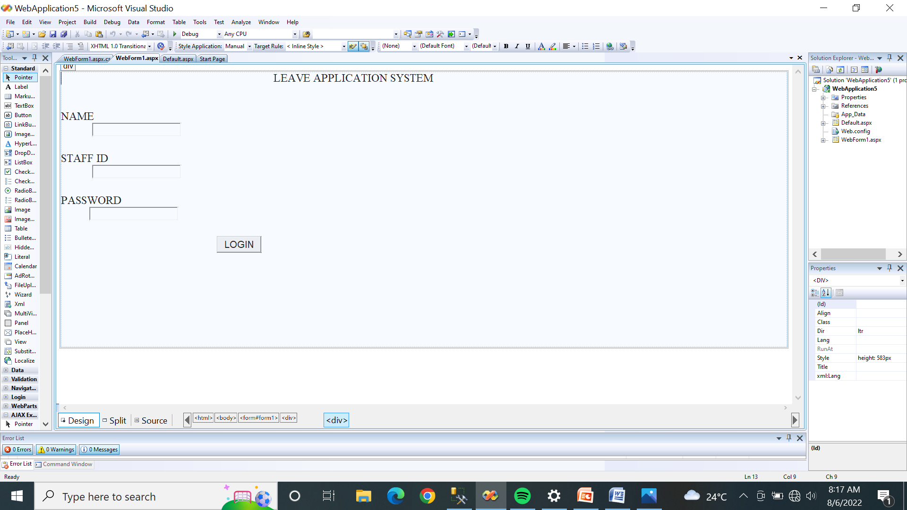

Slide 17
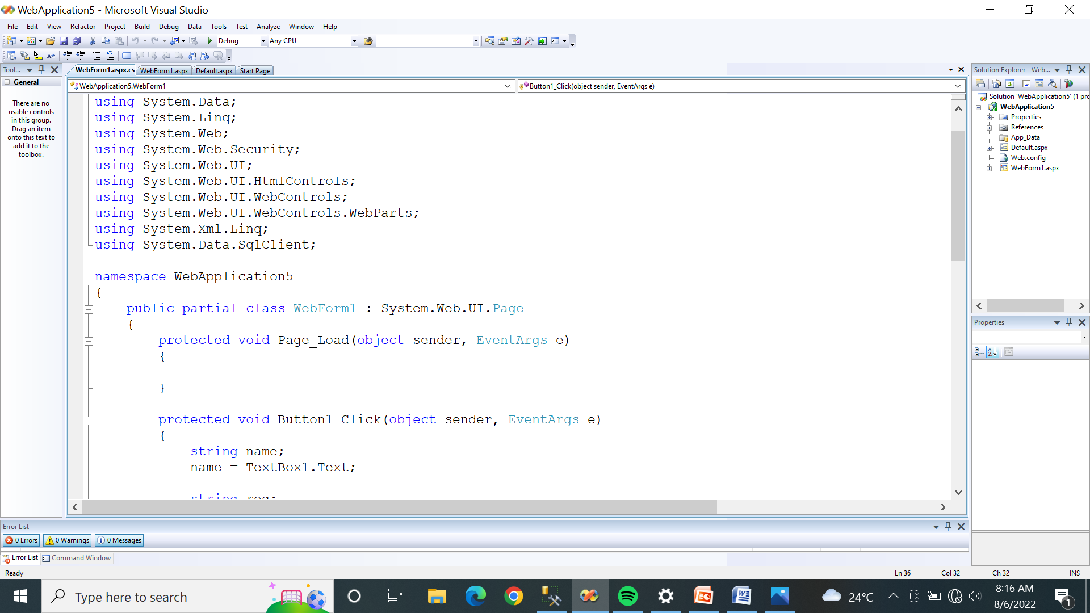

Slide 18
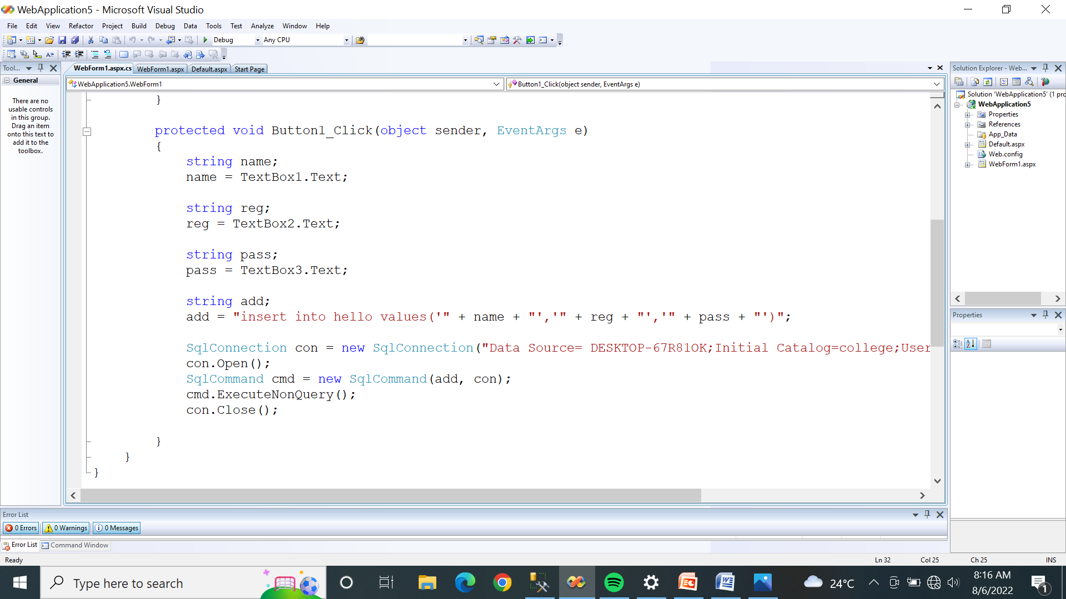

Slide 19
Admin _Login Table:
Column Type | Data Type | Constraints
Login_id | int | Primary key
Username | Varchar(20) | NOT NULL
Password | Varchar(10) | NOTNULL

Slide 20
Staff_Table:
Column Type | Data Type | Constraints
Staff_id | int | Primary key
Staff_name | Varchar(20) | NOT NULL
Staff_Type | int | NOT NULL
Mobile no | int | NOT NULL
Username | Varchar(15) | NOT NULL
Password | Varchar(10) | NOT NULL

Slide 21
Leave Application_Table:
Column Name | Data Type | Constraints
App_No | int | Primary key
Staff_name | Varchar(20) | NOT NULL
Staff_Type | Varchar(10) | NOT NULL
Staff_id | int | Foreign key
Leave_Type_id | int | Primary key
Applying Date | Varchar(15) | NOT NULL
Starting Date | Varchar(15) | NOT NULL
Ending Date | Varchar(15) | NOT NULL
No of days | int | NOT NULL
Reason | Varchar(10) | NOT NULL

Slide 22
Leave_Details Table:
Column Name | Data Type | Constraints
Leave_Det_id | int | Primary key
Leave_Type_id | int | Foreign key
Staff_id | int | Foreign key
App_No | int | Foreign key
Used leaves | int | NOT NULL
Balance leaves | int | NOT NULL

Slide 23
Leave_Report Table:
Column Name | Data Type | Constraints
Leave_Type_id | int | Primary key
Type_Name | Varchar(15) | NOT NULL
No of leaves/year | int | NOT NULL
Description | Varchar(20) | NOT NULL

Slide 24
Leave_Sanction_Table:
Column Name | Data Type | Constraints
Sanction_No | int | Primary key
Staff_id | int | Foreign key
Sanction_Date | Varchar(15) | NOT NULL
Sanction_Status | Varchar(15) | NOT NULL

Slide 25
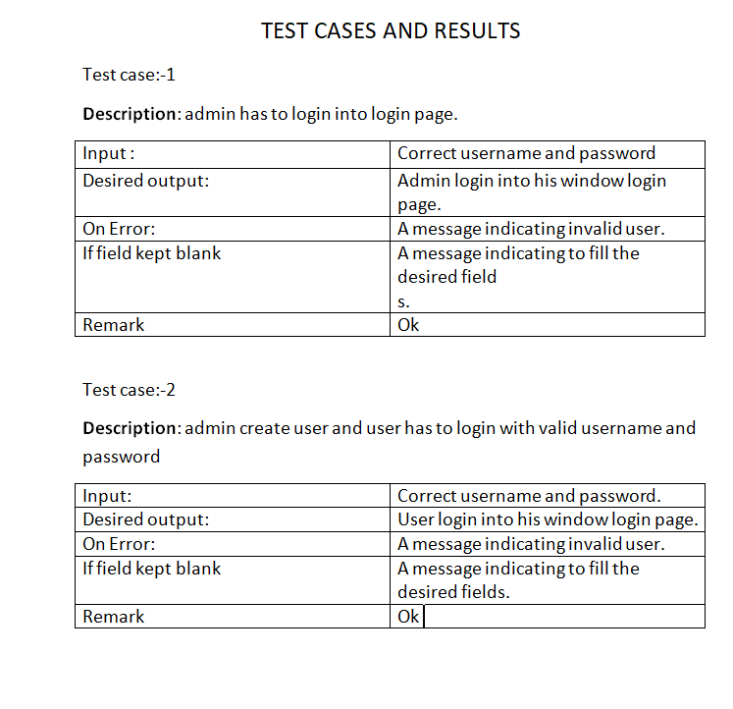

Slide 26
THANK YOU

